Slide 1
Classification of covid-19 using x-ray
Presented by:-
Mahi Gajjar
Pratham Patel
Guided By:-
Prof. Bhavna Makhija

Slide 2
Introduction
The occurrence of the COVID-19 pandemic in 2020 has shaken up the modern world.
Despite having covid testing labs and thermal screeners at place still it seems insufficient to cope with the increasing number of cases. Increasing cases make it difficult for labs to maintain social distancing and lack of kits can sometimes delay the diagnosis.
The automated method will make the diagnosis process quicker as compared to conventional lab testing.
It will further assist radiologists to be more precise in their decision making who would otherwise have to check the X-ray reports manually which consumes more effort as well as time.

Slide 3
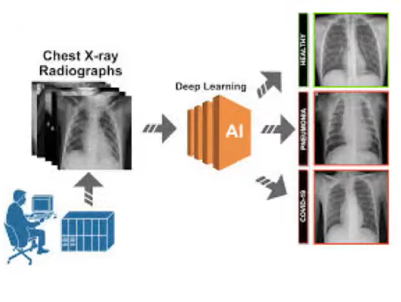

Slide 4
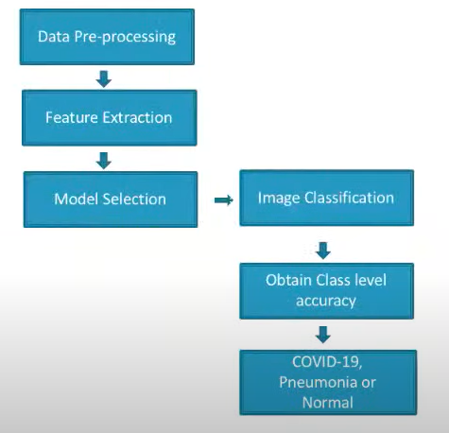
Chest X-Ray Classification – Process Map

Slide 5
DATA pre-processing
Training:
Chest X-Ray Images of COVID-19, Pneumonia ,lung opacityand Normal.
Normalize the data.
Data Augmentation
Resize of images.
Production:
Collect Chest X-Ray Images from patient.
Normalize the data.
Resize of images.
Classifying the images.

Slide 6
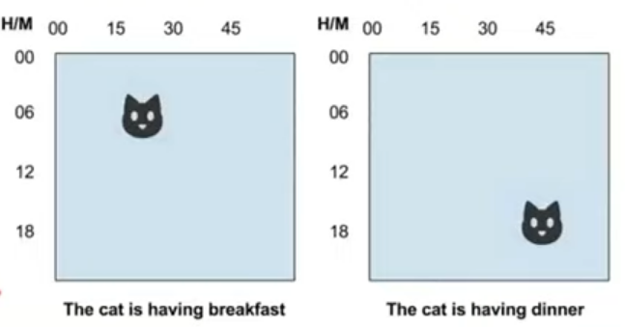
WHY CNN?
The main advantage of CNN compared to its predecessors is that it automatically detects the important features without any human supervision. For example, given many pictures of cats and dogs it learns distinctive features for each class by itself. CNN is also computationally efficient.

Slide 7
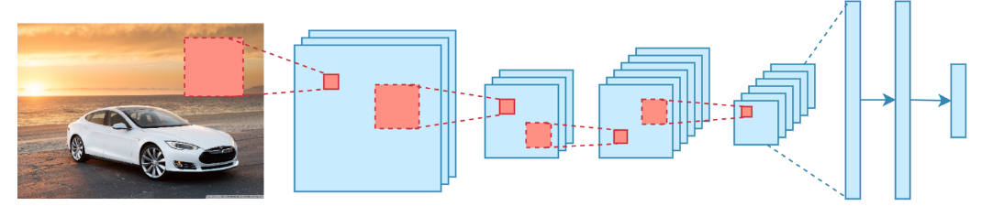
What is cnn?
In deep learning, a convolutional neural network (CNN/ConvNet) is a class of deep neural networks, most commonly applied to analyze visual imagery. Now when we think of a neural network we think about matrix multiplications but that is not the case with ConvNet. It uses a special technique called Convolution. Now in mathematics convolution is a mathematical operation on two functions that produces a third function that expresses how the shape of one is modified by the other.

Slide 8
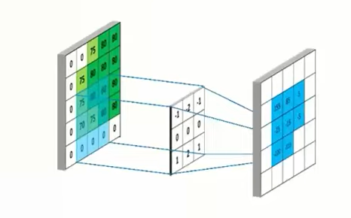
Convolution layer:
A convolution is the simple application of a filter to an input that results in activation. Repeated application of the same filter to an input result in map of activation called feature map, indicating the locations and strengths detected feature in an input, such as an image.

Slide 9
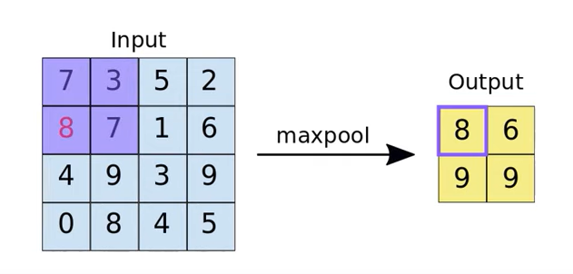
Max Pool:
Max pooling is a pooling operation that calculates the maximum or largest value in each patch of each feature map.

Slide 10
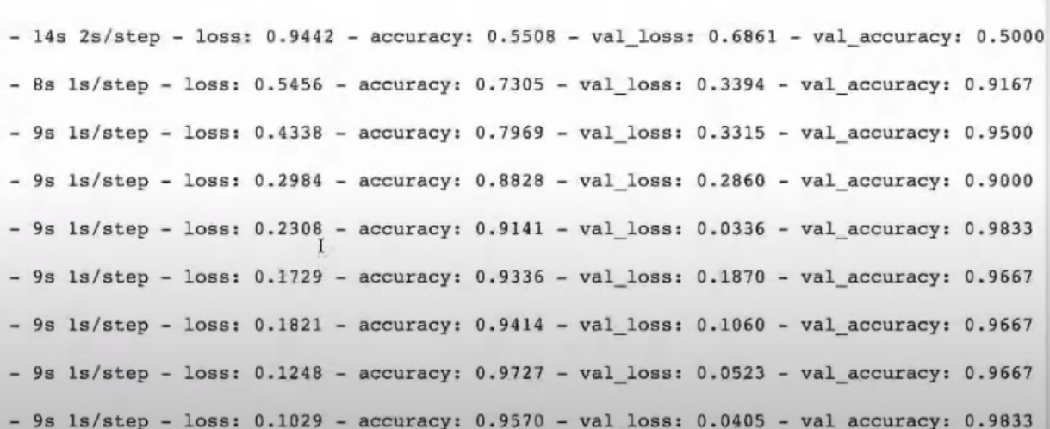
Training and validation accuracy

Slide 11
Key Features:
Time reducing: Users can sit at home and check if they have Covid, Pneumonia or Nothing.
Productivity increases: As the time decreases, productivity increases.
Cost Reduces: As the productivity increases, cost decreases.
Website Design: The look and feel of the website need to be very lively. It has simple layout and easy to understand instructions.
Variety: It just not detects covid, but also detects viral pneumonia and lung opacity.

Slide 12
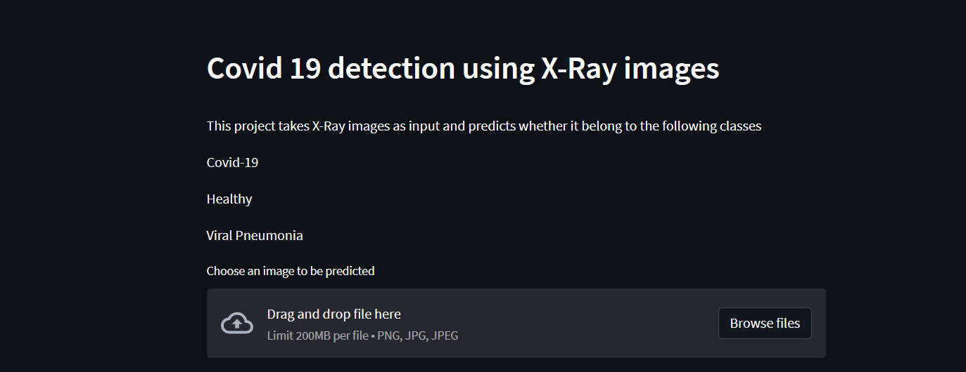
Implementation

Slide 13
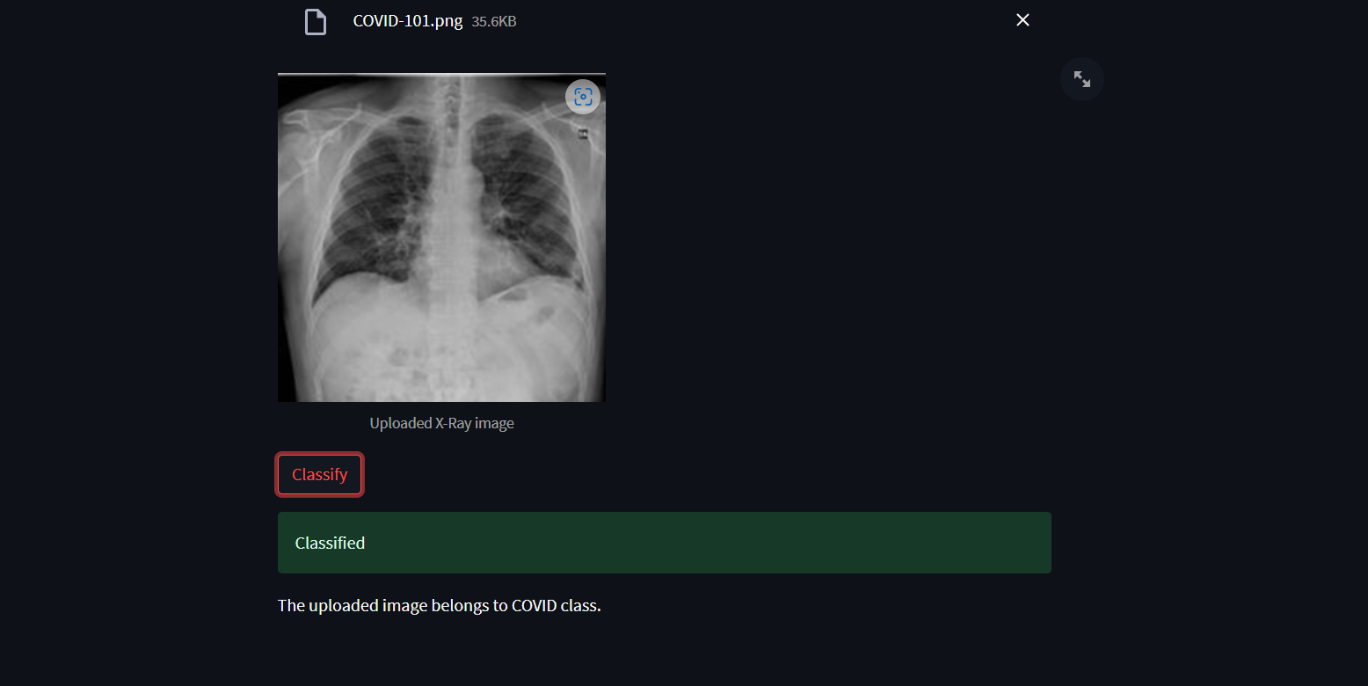

Slide 14
Conclusion
In this paper, a convolutional neural network model was proposed to be developed from the scratch without using any pre-trained models. This model performed exceptionally well on our dataset collected from Kaggle. The training accuracy achieved was 98.12% and validation accuracy achieved was 98.43% outperforming all the other models discussed in the our web app can be accessed through laptop or desktop or even in mobile phones. Thus, it provides a platform through which you can easily get your result predicted within seconds by just uploading your chest radiographs.
And, according to our knowledge, there are no websites providing this service in India. Therefore, we can conclude that by the additional features we provide, our website can reduce the time, cost and energy of people.

